Slide 1


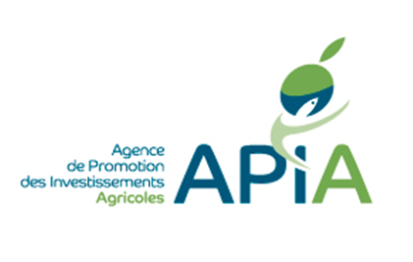
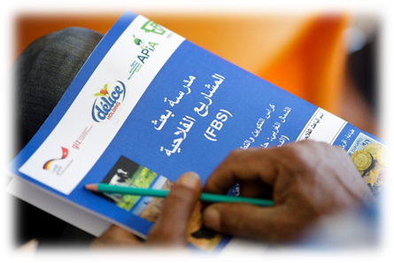

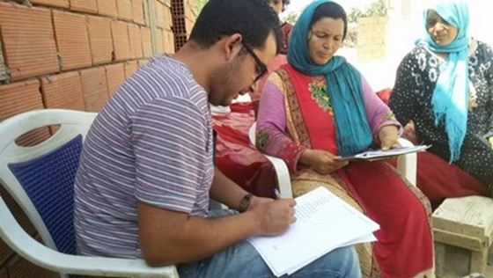
Milk Value Chain Tunisia

Slide 2


The project :Green Innovation Center in Tunisia (GIC)
The Partners
Agricultural Investment Promotion Agency (APIA):
Tunisian government agency under the Ministry of Agriculture, Water Resources and Fisheries (MAHRP) whose main mission is the promotion of private investment in the fields of agriculture, fisheries and associated services
Délice Holding Group:
represented by the Cap-Bon dairy plant, the Northern dairy plant and the Sidi Bouzid dairy plant, is a group of 100% Tunisian companies, leader in the processing of milk and derivatives in the Tunisian territory.
Animal Production and Rangeland Management Agency (OEP):
A public company, attached to the MAHRP, the OEP is in charge of the development and promotion of the livestock and pasture sector and plays a role of adviser and technical reference for the public authorities.
Office de l’Elevage et des Pâturages

Slide 3
The Tunisian dairy sector is characterized by:
An important number of small dairy producers (112.000), 83% have less than 10 cows.
Only 7% of the farms have more than 50 cows
Contributes with 15,7% of the overall value of agricultural production
The herd is about 450 thousands female heads
73% of the producers own less than 10 Ha
Challenges
Promotion of productivity through training of farmers/breeders about best agricultral practices, entrepreneurship
The sector organisation and reinforcing the professionnal structures and dialogue platforms
Improving the quality through installing cooling systems in farms , best hygiene parctices
Improving the daily tasks by providing innovative equipment

Slide 4
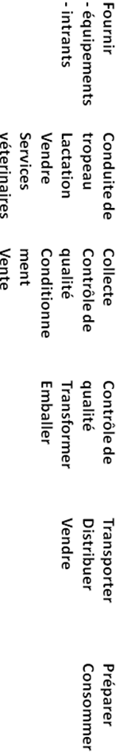
Carrefour
Géant Casino
Magasin Général
Monoprix
Superettes and small shops
Carrefour
Géant Casino
Magasin Général
Monoprix
Superettes and small shops
112000 breeders
112
breeders
43 industrial units
240 CCL
43 industrial units
240 CCL
(collection centers)
Industriel
IAAA
CCL
OEP

Slide 5
vulnerability to climate change
Climate studies on Tunisia have shown the country vulnerability to climate change and, in consequence, that its economy, population, and ecosystems are at high risk of being negatively impacted. Livestock, a vital activity in Tunisia, represents a significant source of greenhouse gases (GHGs) emissions among agricultural activities, generating carbon dioxide (CO2), methane (CH4), and nitrous oxide (N2O) throughout the production system. Livestock contributes to climate change by emitting GHGs either directly (from enteric fermentation and manure management) or indirectly (from feed-production activities and conversion of forest into pasture or cropland). CH4 is the most predominant GHGs produced (92%), mainly from dairy cattle (53%). Poultry was the highest emitter of N2O.

Slide 6
GHG Emissions
 | Emissions CH4 (Gg) | Emissions N2O (Gg)
EMISSION (Gg) | 104,8 | 0,771
(Gg eCO2) | 2 849
26% of gross GHG emissions from the agricultural sector.
+ 6% of gross national GHG emissions
6

Slide 7
Thanks for your attention !

